Slide 1
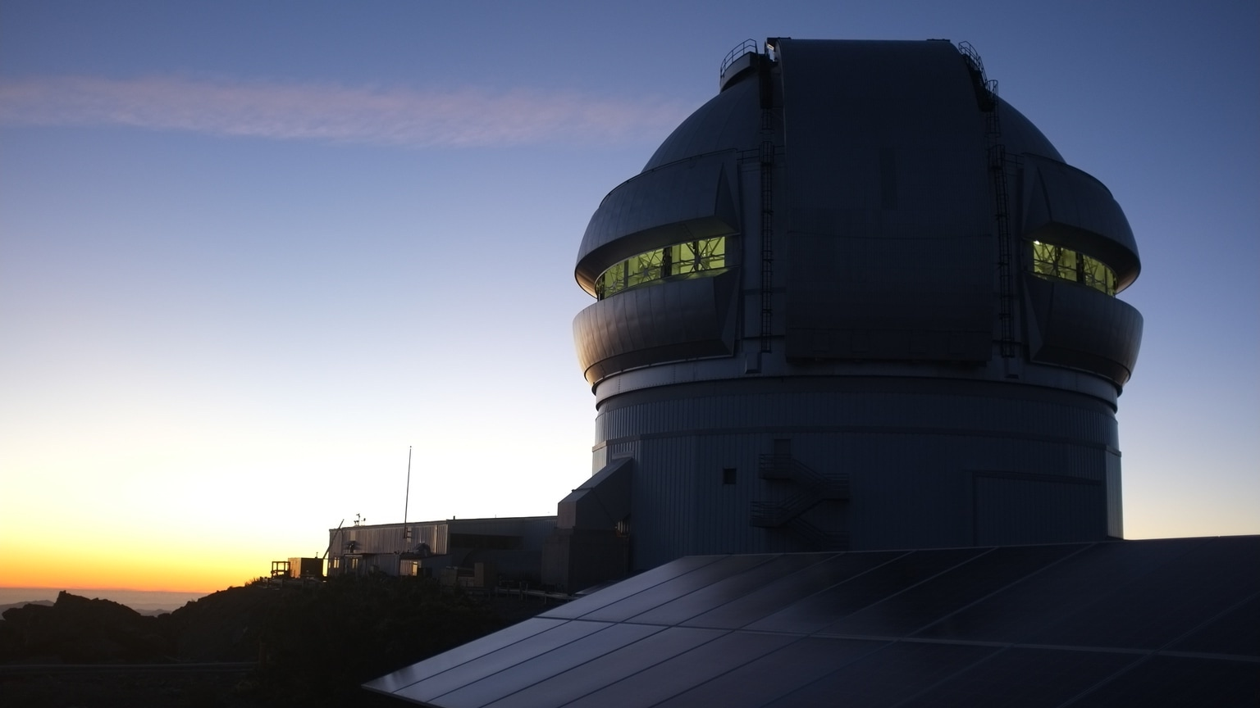




The COBREX Gemini Planet Imager archival survey Occurrence rate of wide-orbit substellar companions & a new circumbinary companion
Johan Mazoyer, Vito Squicciarini, Antoine Chomez, Anne-Marie Lagrange, C. Wilkinson P. Delorme, O. Flasseur, F. Kiefer, S. Bergeon, A. Radcliffe, E. Alecian, D. Albert, N. Meunier

Slide 2
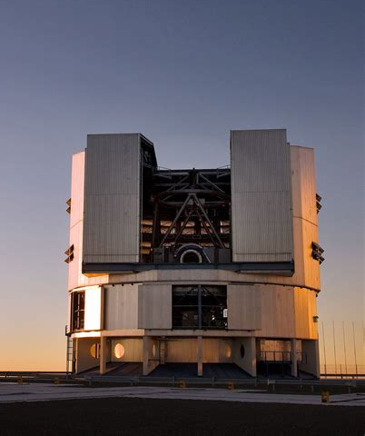

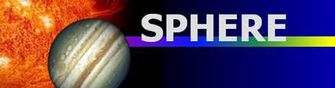
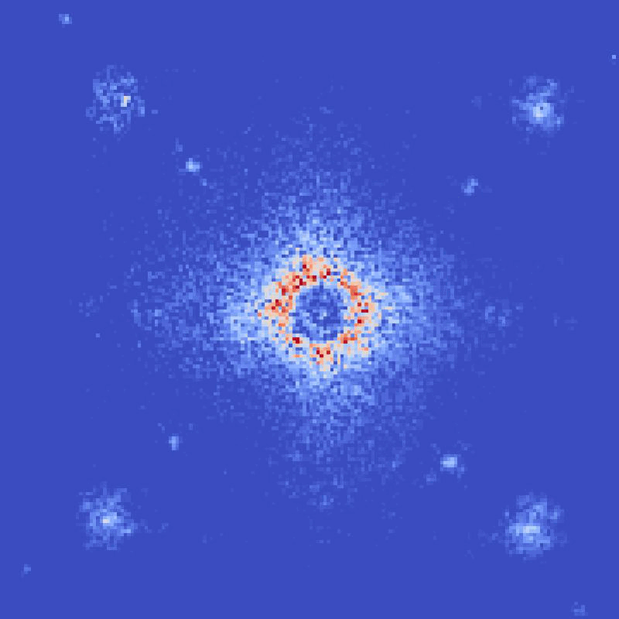
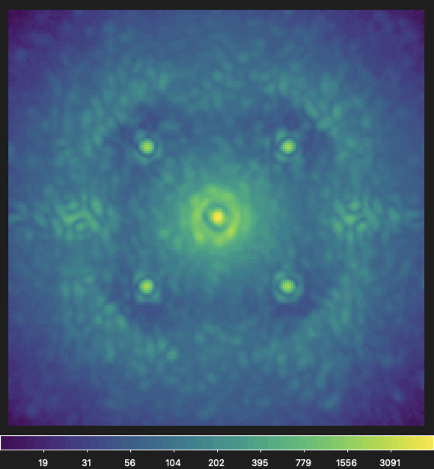
Two (competing) coronagraphic instruments
Gemini planet Imager
Very Large Telecope / SPHERE
2014 – 2020 Decommissioned
2014 - … Still operational
643 different stars
854 sequences
(removing <5 frames sequence)
30 703 IFS cube (H only)
550 different stars (SHINE + BEAST)
892 sequences
IFS + Imager (IRDIS)

Slide 3
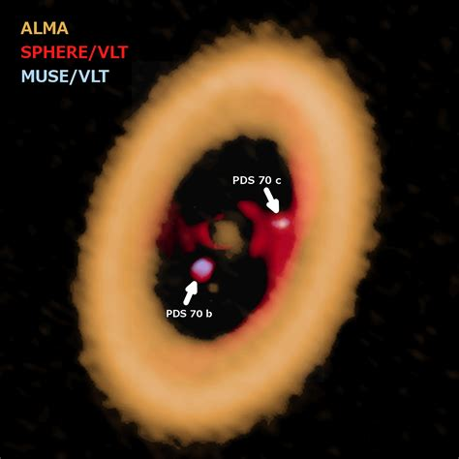
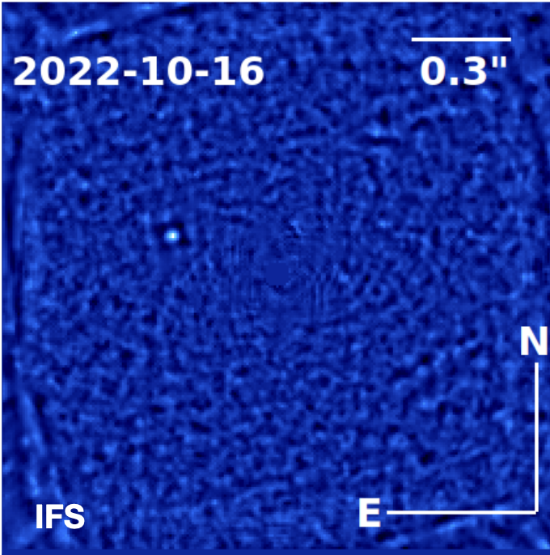
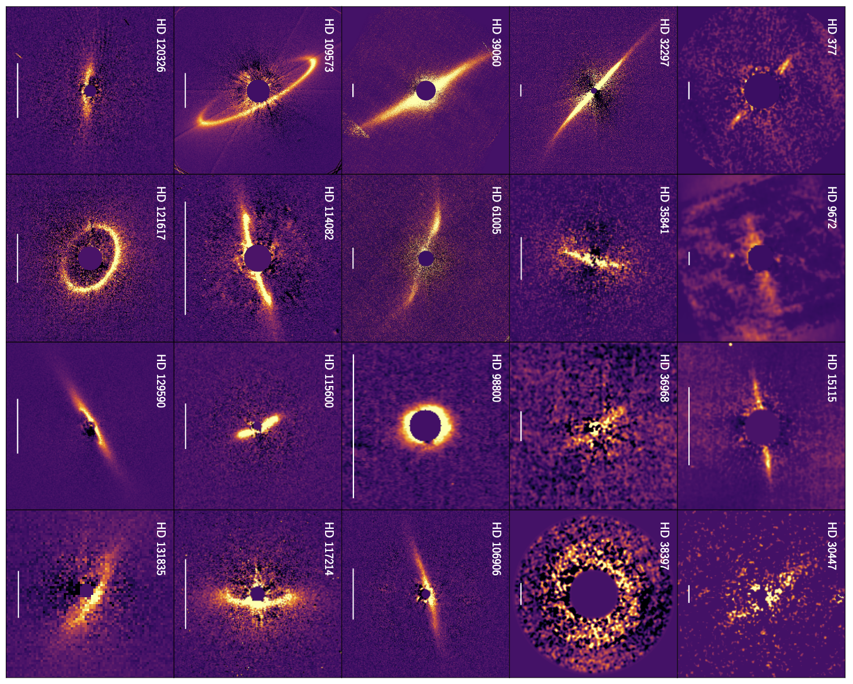
Two (competing) coronagraphic instruments
Gemini planet Imager
Very Large Telecope / SPHERE
>10 planets (see Chauvin et al 2023 review)
1 planet: 51 eri b
(Macintosh+ 2015)
PDS 70 b&c
Keppler+ 18, Haffert+19
AF Lep b
Mesa+22
~50 debris disks
(Engler+ 2025)
~30 debris disks
(Esposito+ 2020)

Slide 4
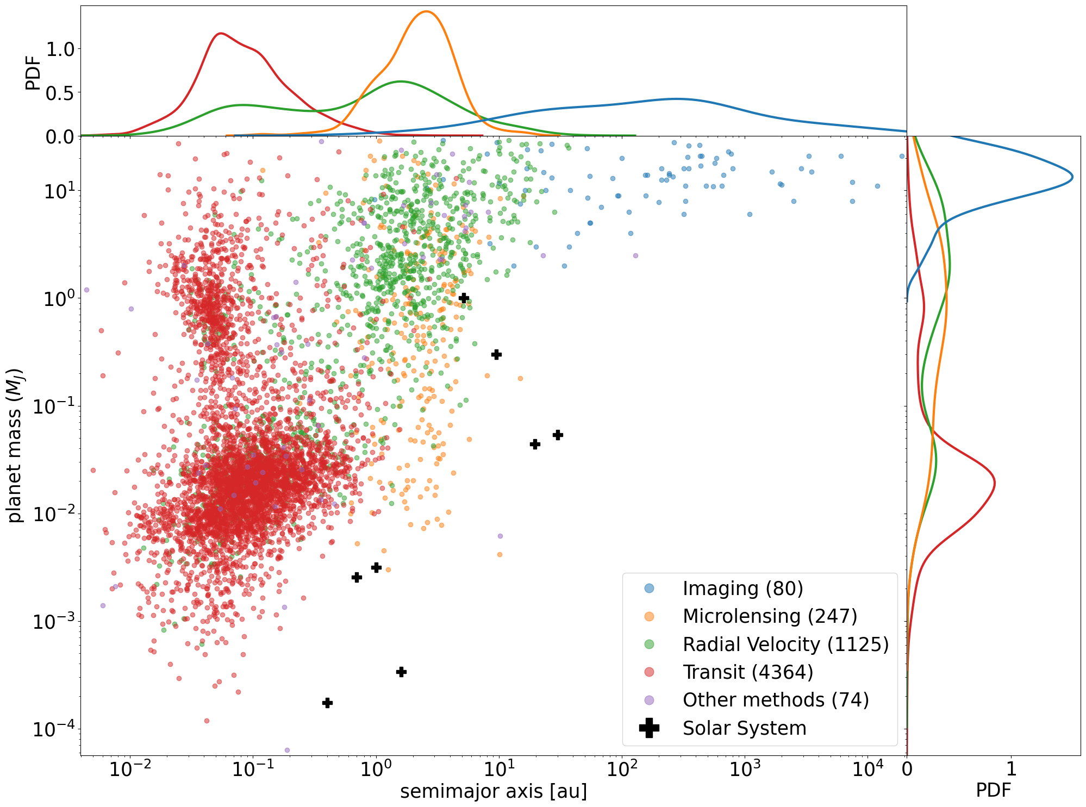
Why direct imaging ?
Different detection techniques probe different regions of parameter space
A complete and unbiased coverage of the parameter space is the key to understanding planet formation processes
Direct imaging enables detection of giant planets in the outer regions (≳10 au) around young (≲500 Myr) stars

Slide 5
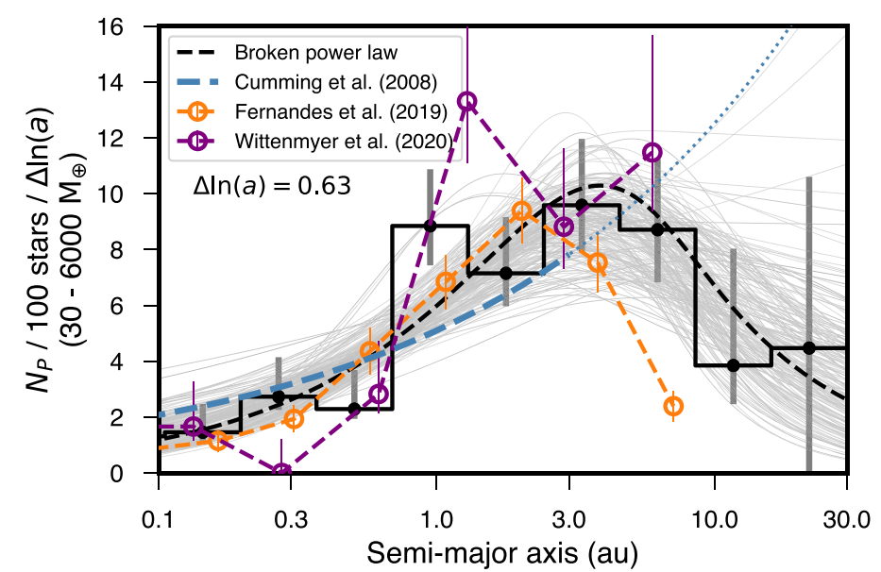
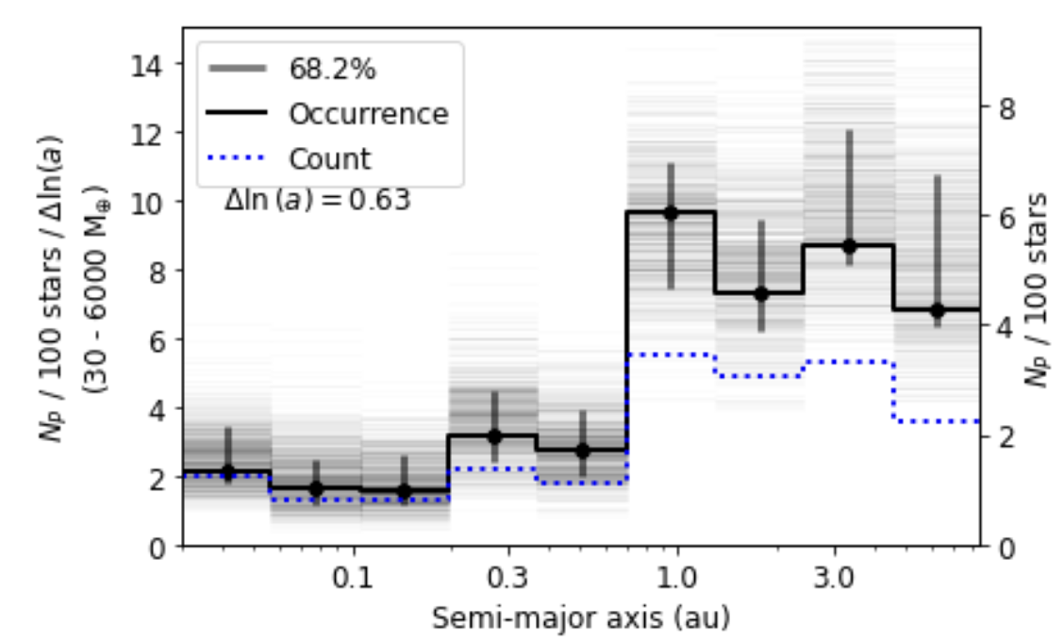
Why direct imaging ?
0.03 au < a < 30 au
0.1 M_{J} < M_{P} <20 M_{J}
Fulton+2021
0.03 au < a < 10 au
0.1 M_{J} < M_{P} <20 M_{J}
Lagrange+2023
Most of our current understanding of the giant population is based on radial velocity studies

Slide 6
Two (competing) coronagraphic instruments
Gemini planet Imager
Very Large Telecope / SPHERE
Nielsen et al 2019
Vingan et al 2021
GPI First 300 stars
SHINE First 150 stars

Slide 7
Finding planets in coronagraphic images
Spectral Differential Imaging
Angular Differential Imaging

Slide 8
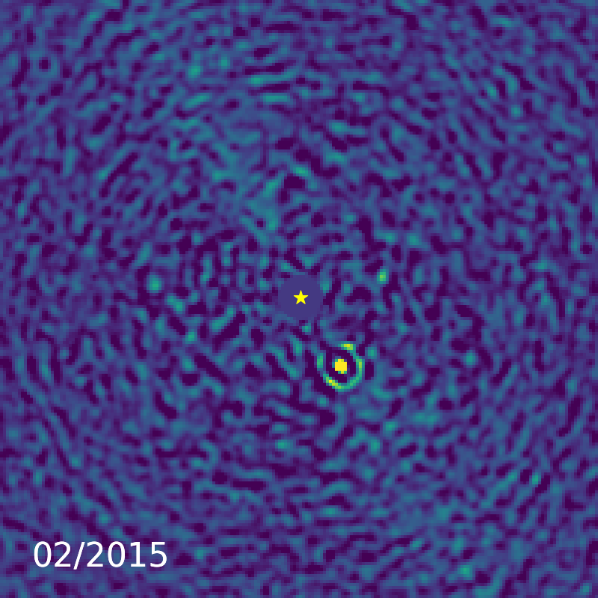
The Cobrex archival work
Beta-Pictoris b
Baseline post-processing of SPHERE (Galicher+ 2018)
based on Lafrenière+ 2007, Soummer + 2012
PACO (Flasseur et al 2018)
Increase sensitivity
S/N maps can be considered as Gaussian !
Galicher & Mazoyer 2023
State-of-the-art post-processing algorithms can yield significant performance improvement
PI: A-M Lagrange

Slide 9
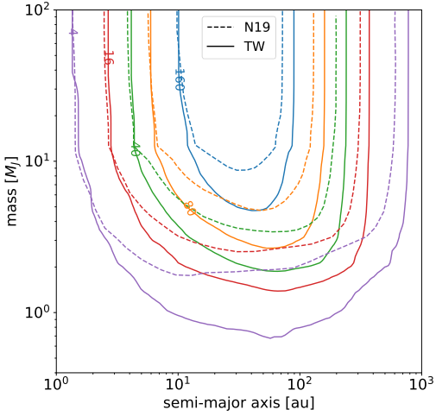
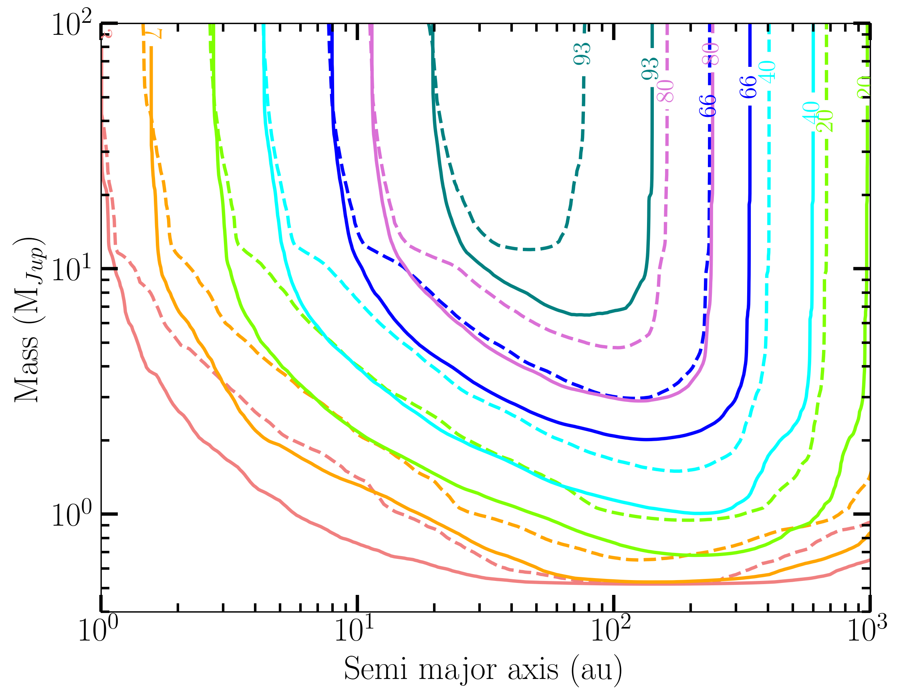
Enhanced sensitivity
Gemini planet Imager
Very Large Telecope / SPHERE
GPI First 300 stars, reanalysis
SHINE First 150 stars, reanalysis
2 M_{J} planet @ 100 au
SPECAL : 66% detection PACO : 80% detection
Squicciarini, Mazoyer, Lagrange et al 2025
Chomez, Delorme, Lagrange et al 2025

Slide 10
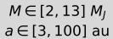
GPI 400 stars: largest direct imaging survey to date
Thanks to the larger completeness, derived rates typically more precise than literature ones
GPI First 300 stars, reanalysis
GPI First 400 stars
Squicciarini, Mazoyer, Lagrange et al 2025

Slide 11
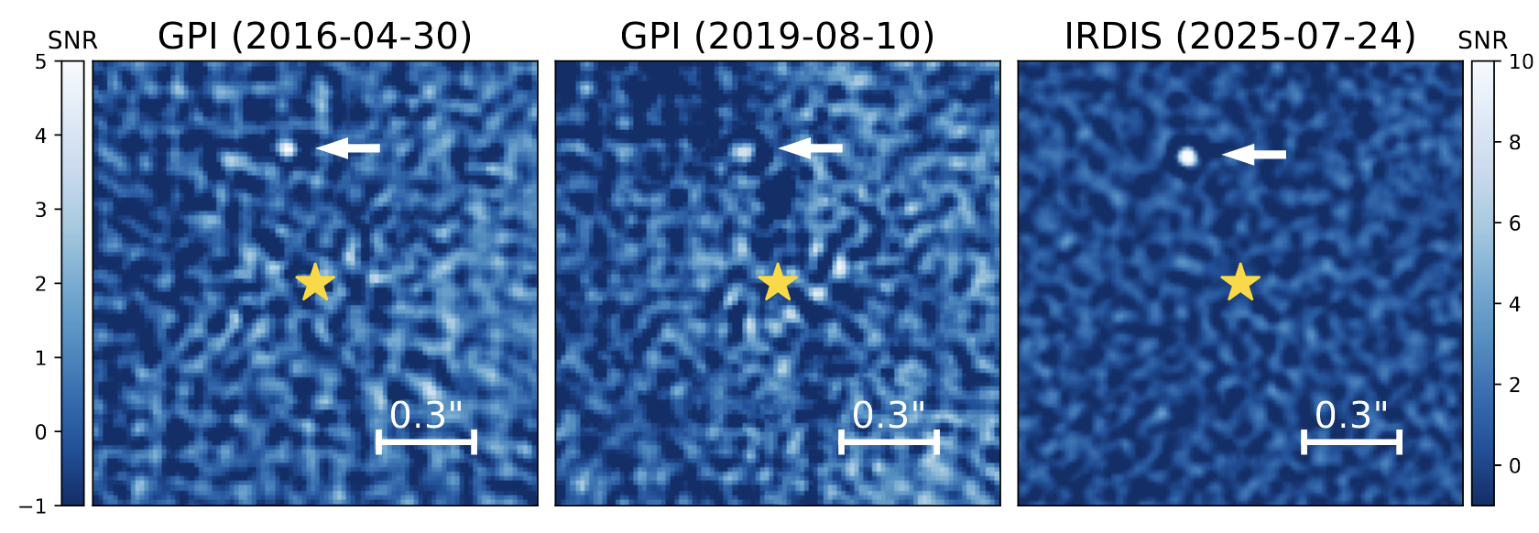
Detecting new planets ?
Thousands of sources detected
Most of them are unrelated background stars
Proper motion and color analysis to identify substellar companions
Two promising candidates
named in the paper
HD 24072
HD 143811
Second epoch only 3.5σ
HIP 78663 /
HD 143811
Most promising candidates were proposed for reobservation with SPHERE in 2025
Squicciarini, Mazoyer, Lagrange et al 2025a

Slide 12

Drama over the summer!

Slide 13
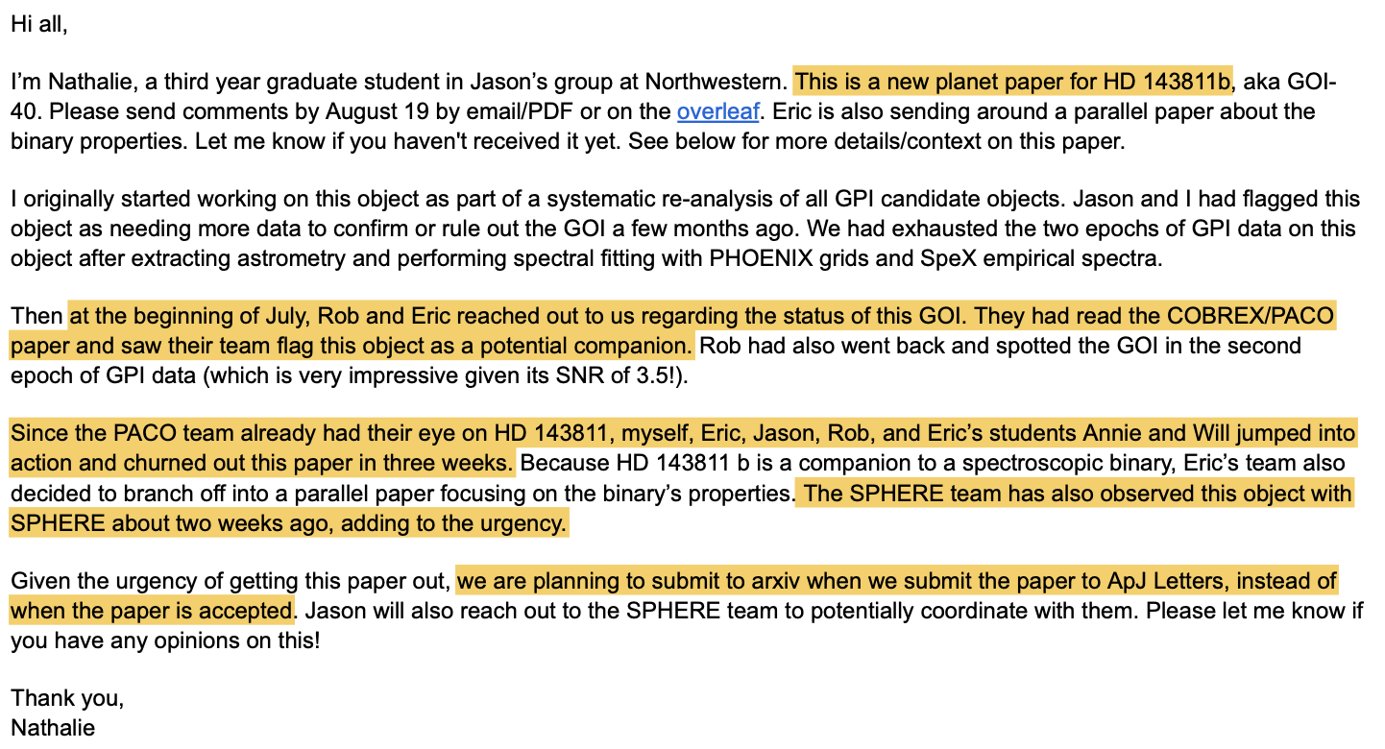

Drama over the summer!

Slide 14
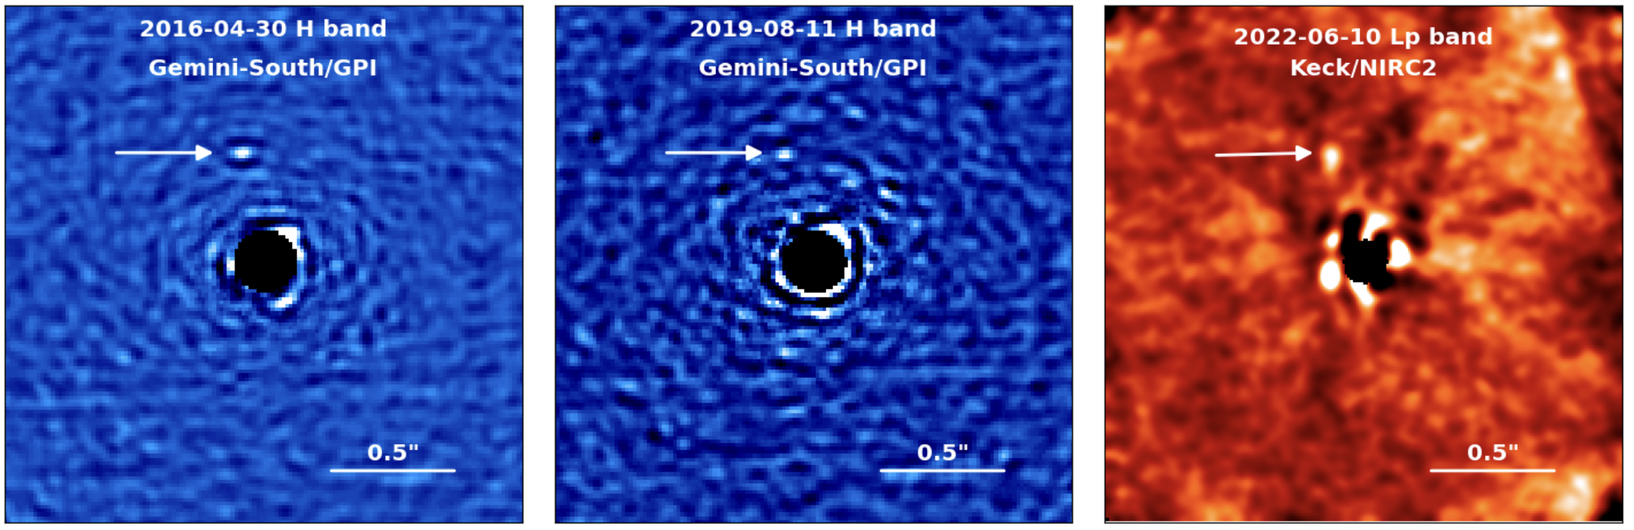

HD 143811 AB b : searching for a 3rd point
Jones, Wang, Nielsen et al 2025
3rd point: Keck (June 22)
`
Squicciarini, Mazoyer, Wilkinson et al 2025
Both paper submitted on Arxiv simultaneously on
September 25th 2025
3rd point: SPHERE (July 25)

Slide 15
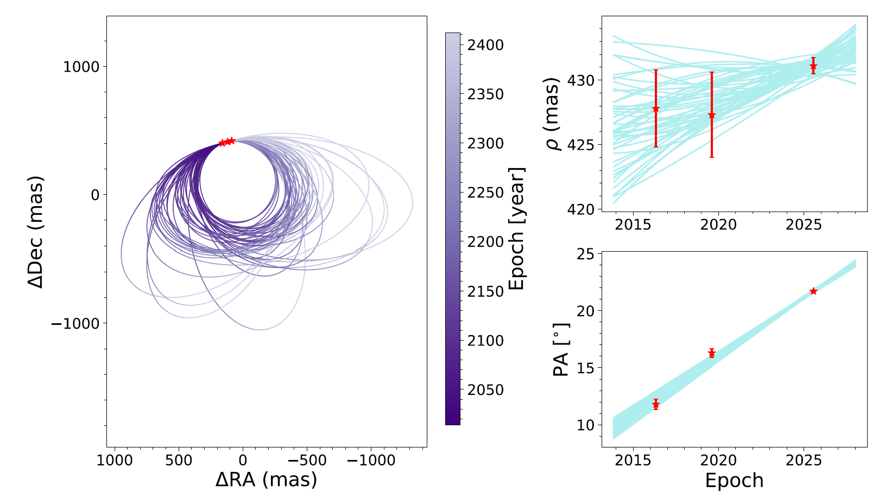
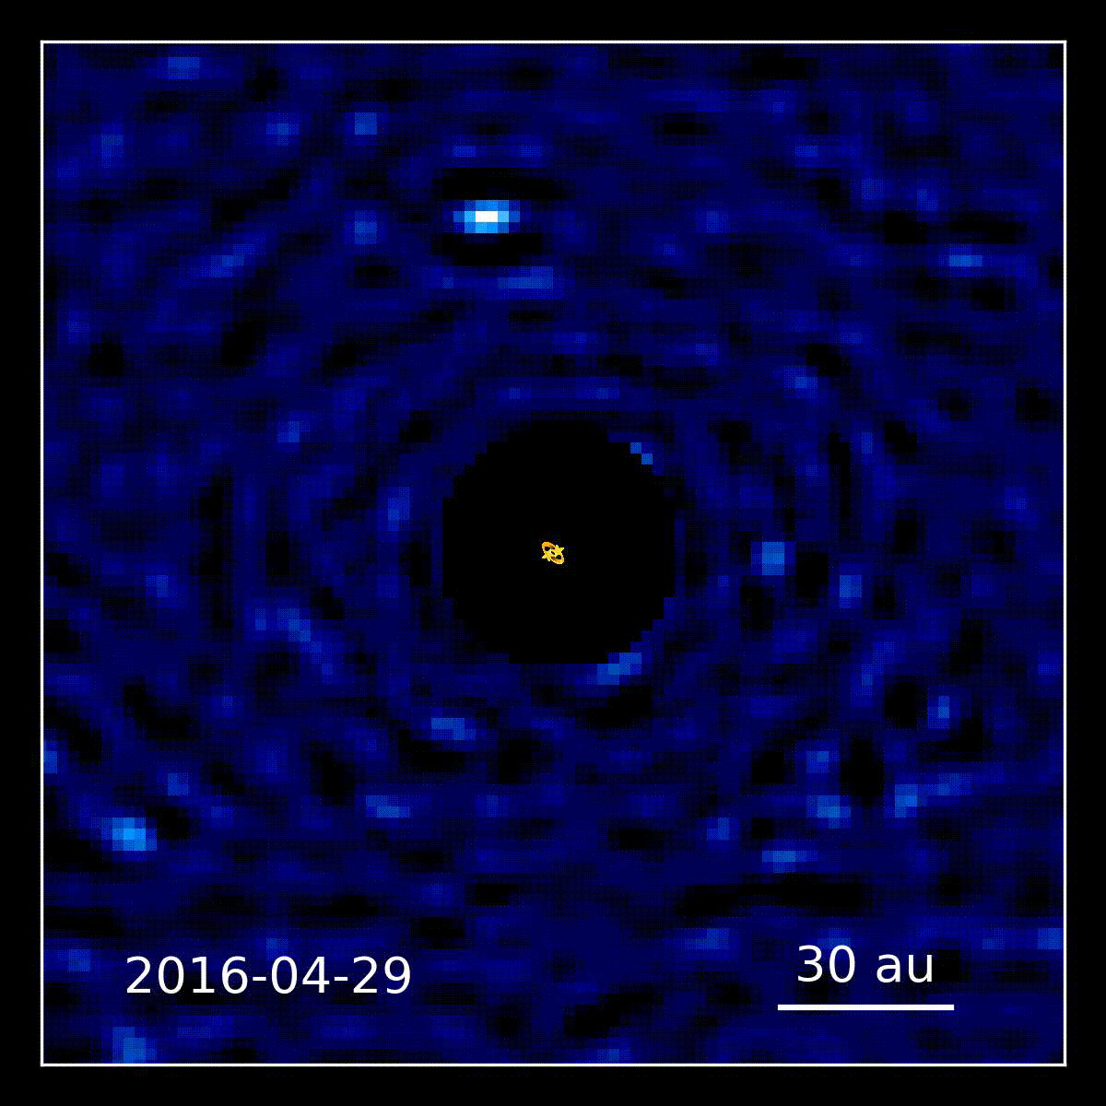

HD 143811 AB b : a circumbinary planet at 60 au
Squicciarini, Mazoyer, Wilkinson et al 2025
2nd planet ever discovered by GPI.
1st circumbinary planet imaged < 100 au.
Binary semi-major axis of 0.19 au
Planet @ 63 au =>
Jones, Wang + 2025
HADES (Wilkinson+24), a self-consistent model coupling an atmospheric model and an interior model to constrain mass, temperature, metallicity
The planet has a mass 6±1 M_{J} assuming a warm-start scenario

Slide 16



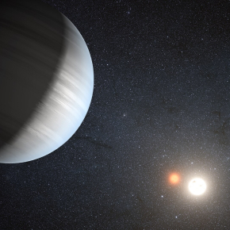
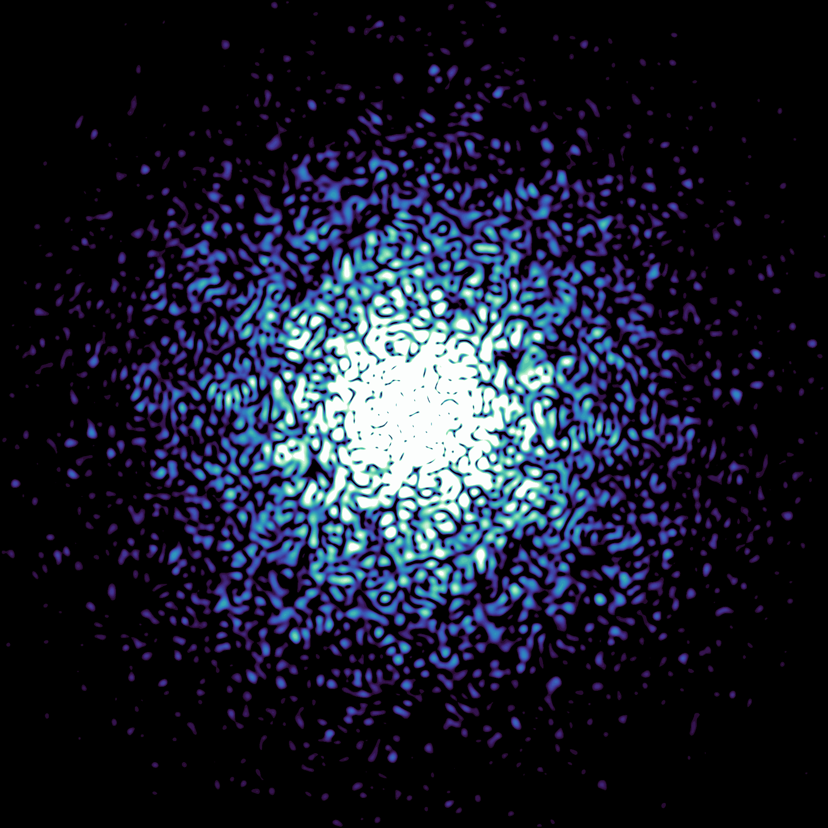

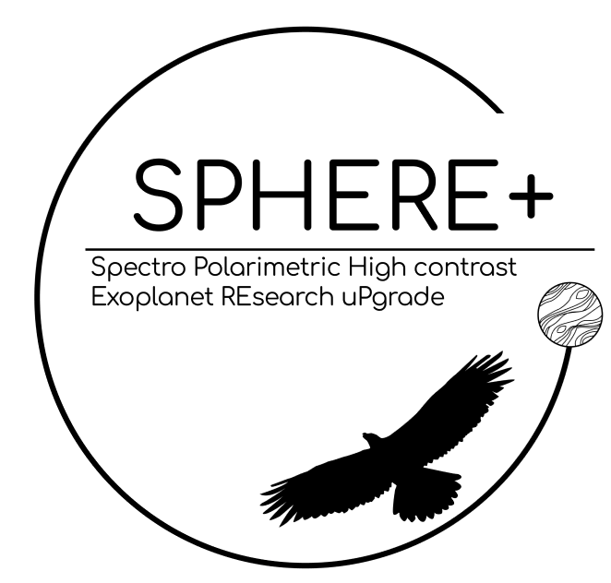

Thank you !
Antoine Chomez
(now payload specialist
in OHB Sweden)
Vito Squicciarini
(now postdoc in Exeter)
Christian Wilkinson
Opening two postdocs positions in 2027 in direct imaging observation and / or instrumentation

