Slide 1



Large-scale hydrogen reactions with magma oceans change
the atmosphere of exoplanets
Razvan Caracas
Institut de Physique du Globe de Paris
caracas@ipgp.fr

Slide 2
COMPUTATIONAL MINERAL PHYSICS
First-Principles Molecular Dynamics
Atoms move according to interatomic forces
Forces are computed using Density Functional Theory
                (PBE GGA, spin-polarized)
Analyze using statistical physics tools
Identify bonds (pair distribution function - supplementary material)
Build chemical speciation
Separate liquid and vapor
Compute hydrogen dissolution

Slide 3
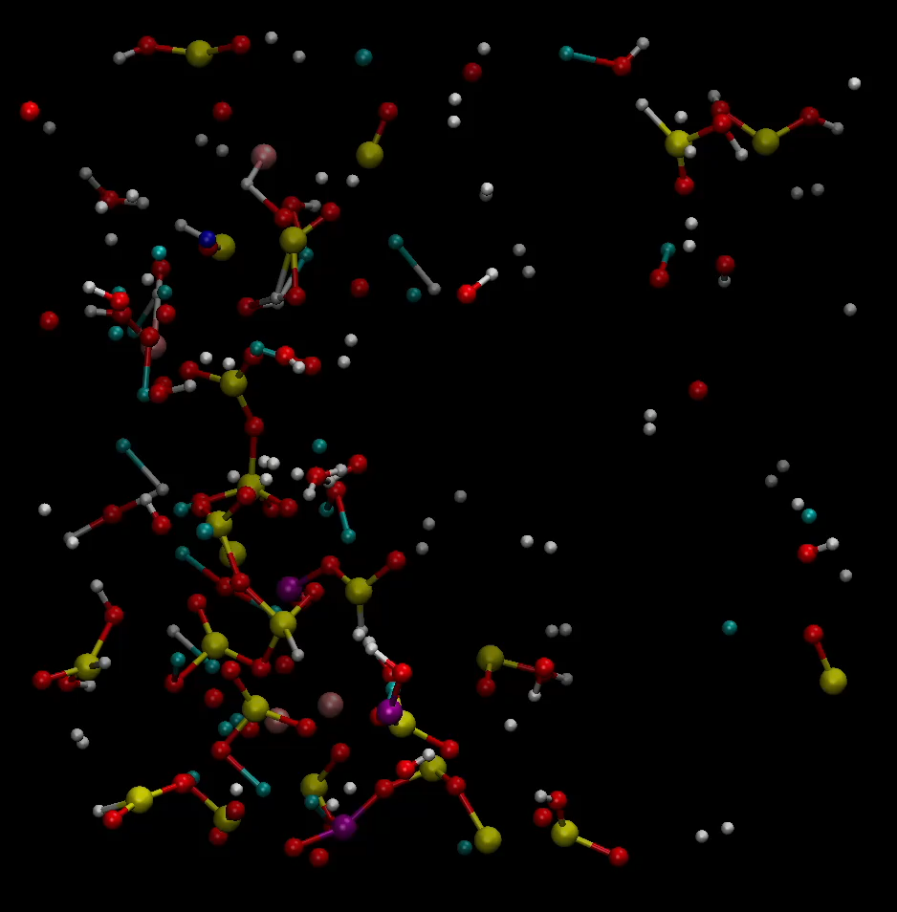
ρ = 0.2 g/cm3, T = 4000K => hot relatively dense nebular gas
153 atoms of
bulk silicate Earth
“pyrolite”
+
50 H₂ molecules
(~3 wt%)
Inside the immiscibility gap
Low-density
High-temperature
(based on Caracas, EPSL, 2024)

Slide 4
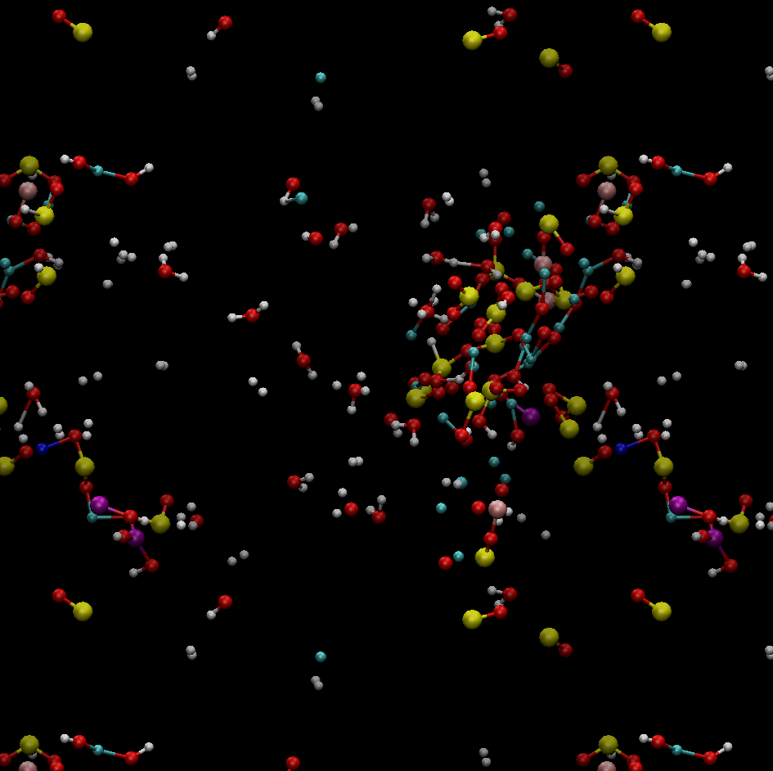
ρ = 0.2 g/cm3, T = 4000K => hot relatively dense nebular gas
H atom
“Liquid”
H₂ molecule
H₂O molecule
SiO
OH

Slide 5
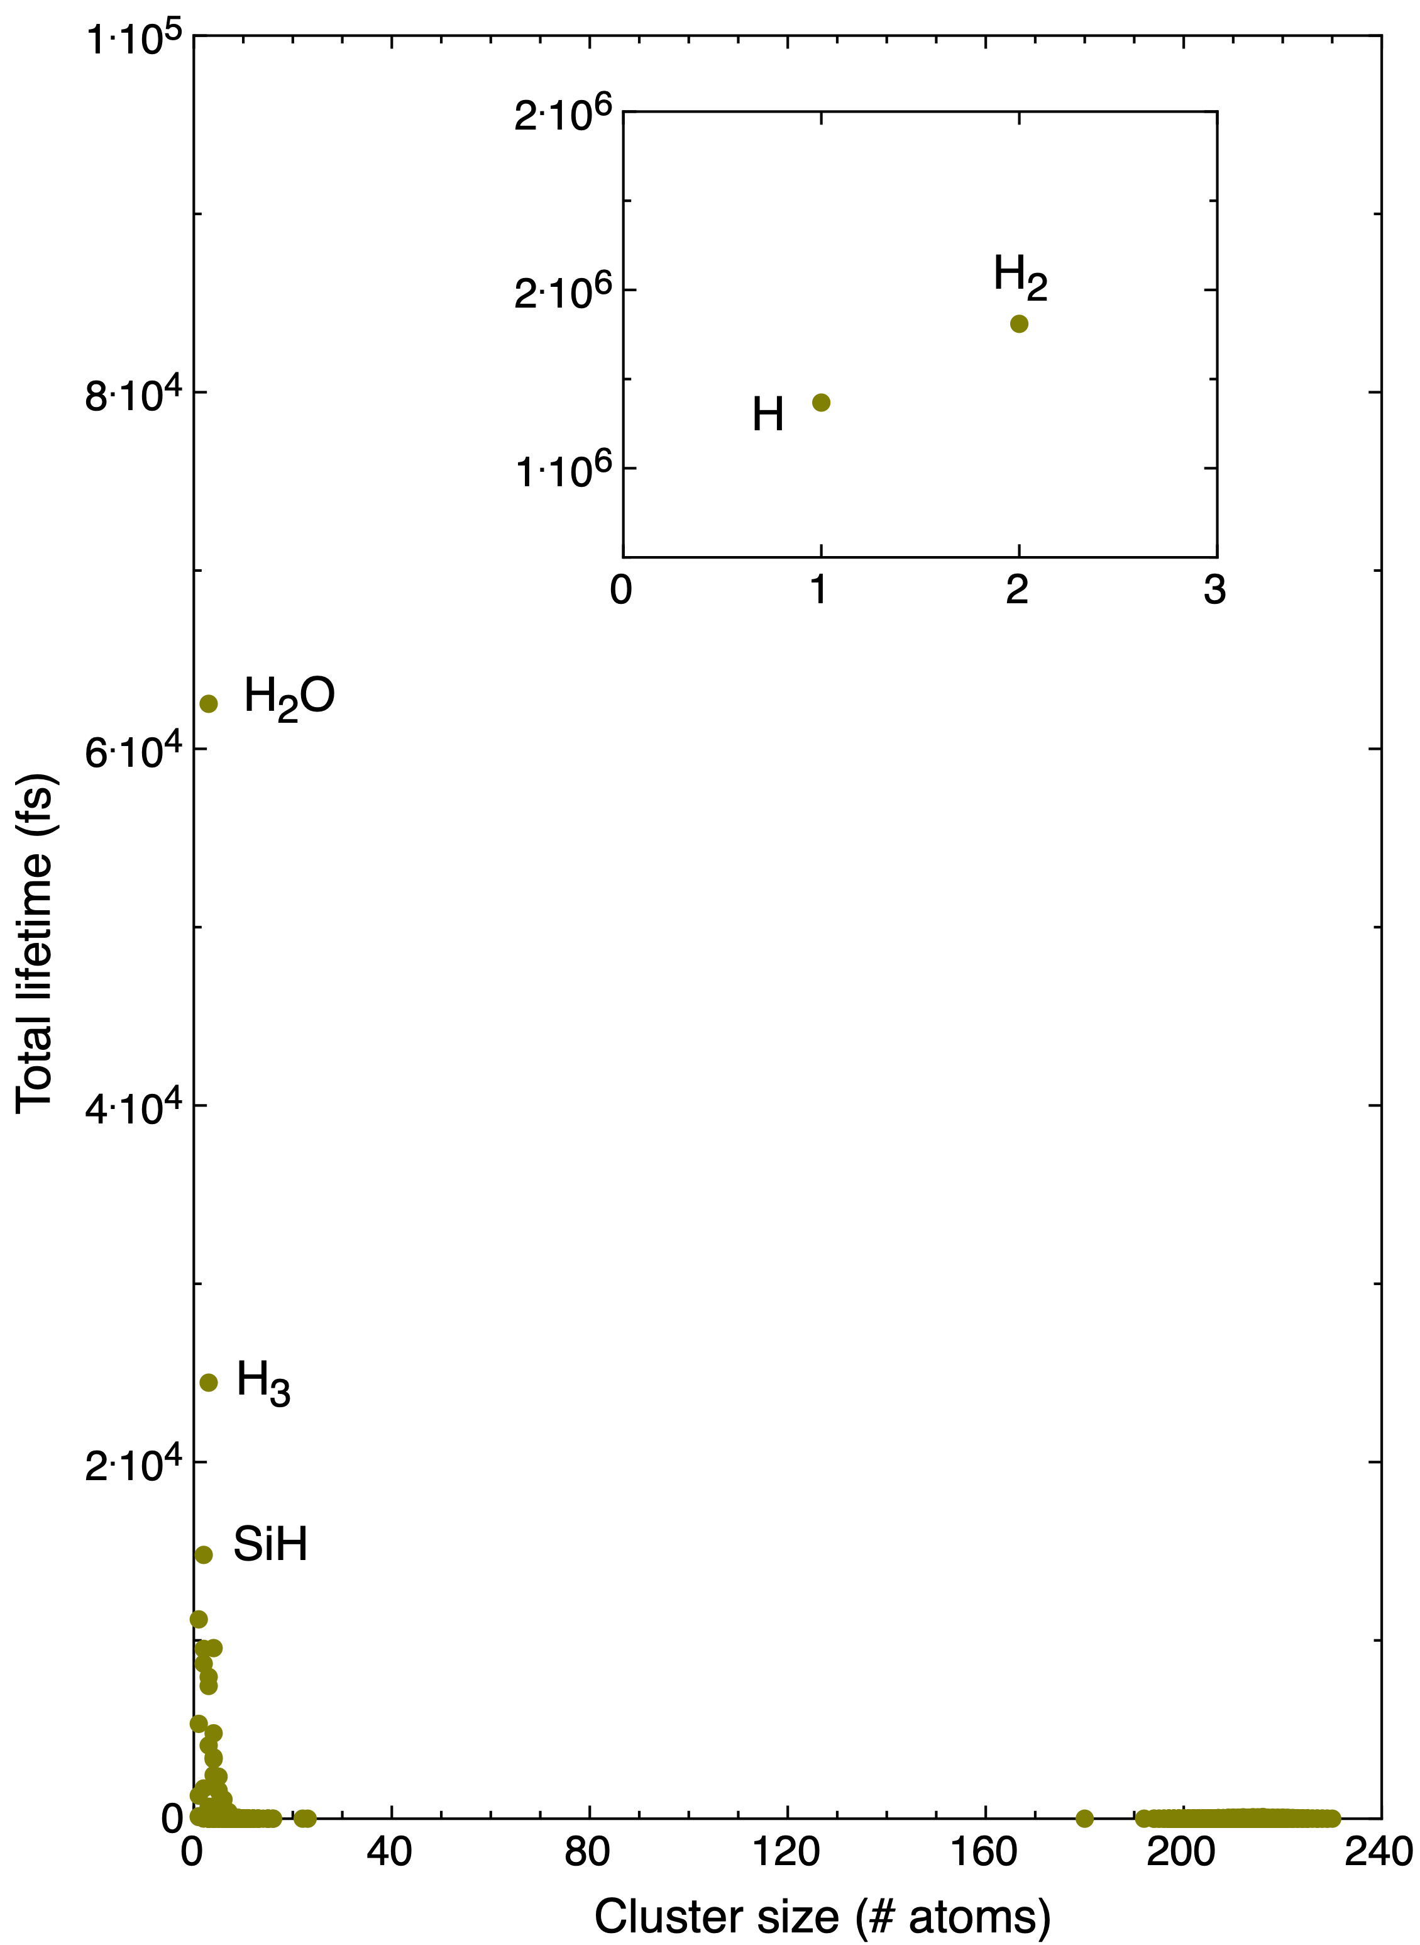
ρ = 0.2 g/cm3, T = 4000K => hot relatively dense nebular gas
bimodal distribution of the atomic clusters

Slide 6
ρ = 0.2 g/cm3, T = 4000K => hot relatively dense nebular gas
major species, > 1 mole %, L < 12 atoms

Slide 7
ρ = 0.2 g/cm3, T = 4000K => hot relatively dense nebular gas
minor species, 1 > x < 0.1 mole %, L < 12 atoms

Slide 8
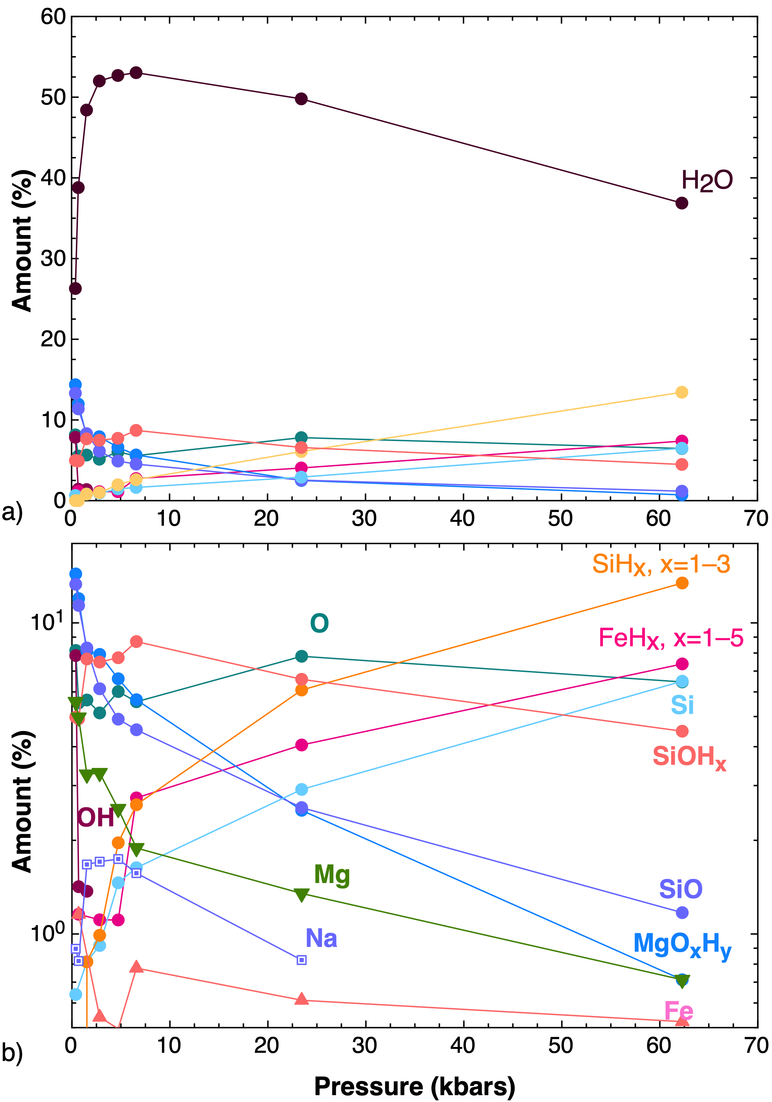
Atmosphere composition (without H₂ and H) along 4000K
Might be a key for observations
Pressure (kbars)
@
atmosphere/magma ocean
interface

Slide 9
In the magma: Si speciation (=coordination) by O and H
Abundance (%)
Density (g/cm³)

Slide 10
Liquid – vapor relations along 4000K
Low-P: clear distinction
High-P: statistical measures to identify bubbles

Slide 11
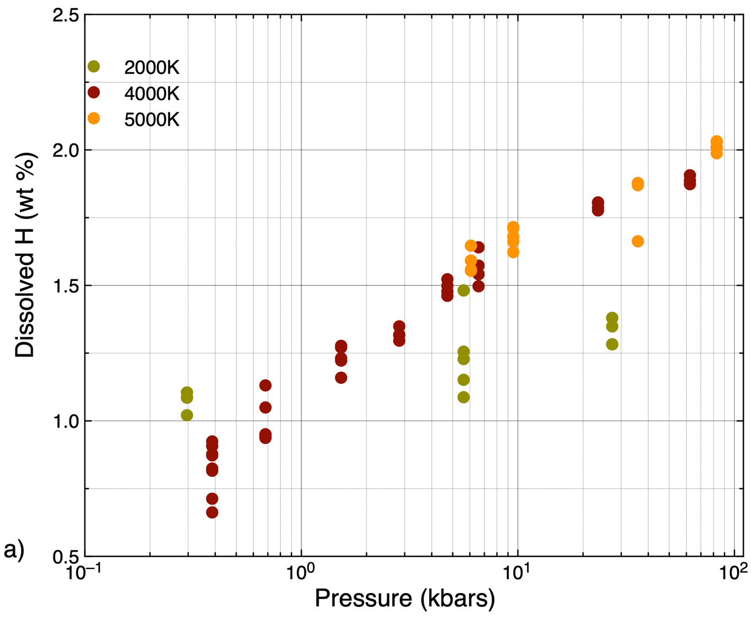
Hydrogen solubility in the magma ocean (for sub-Neptunes)
Immiscibility gap should close
above the 5000K
(based on Caracas & Stewart, EPSL, 2019)
Signs of gap closure

Slide 12
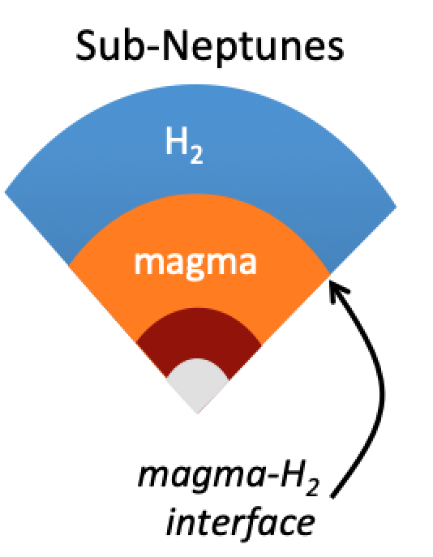
Effect of H incorporation on the magma density
Promotes layering
Chemical insulation

Slide 13
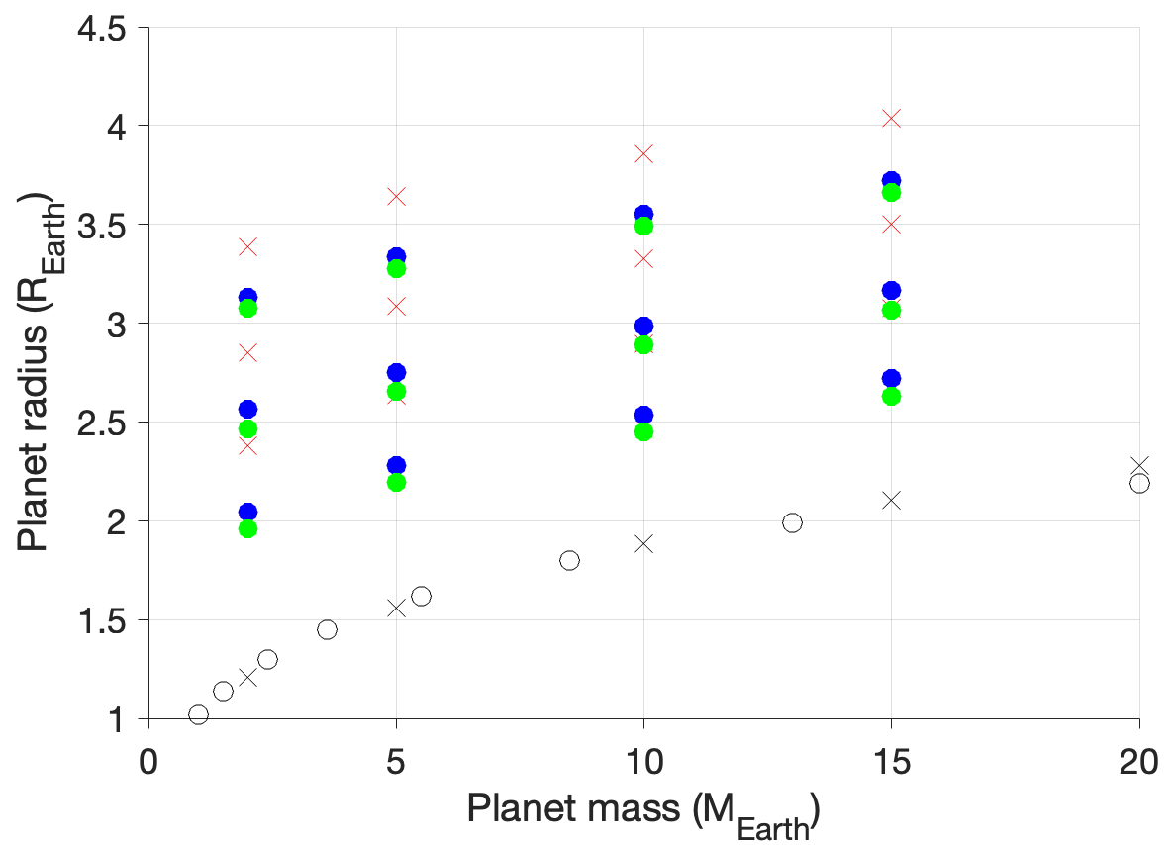
Does it really matter for sub-Neptunes’ size? And how?
Envelope:
10 wt%
5 wt%
2 wt%
no dissolution
with dissolution
bare-rock
MESA simulations by Howard Chen (Florida)
Notes:
In the plot below, the blue dots are MESA radii with zero dissolution into the core, for envelope mass fractions of 2 wt%, 5 wt%, and 10 wt%. The green dots show planet shrinkage including dissolution into the core and (interpolated) core puff-up. The red crosses are just for reference (they correspond to MESA runs with core puff-up in an extreme case, with no dissolution). The black symbols are for the bare-rock case.

Slide 14
Conclusions
Large-scale (~2wt%) hydrogen dissolution in silicate magmas (at high P & T)
Large-scale chemical reactions
Chemical changes
Redox changes
Chemical atmosphere signature (H₂O:CO₂ ratio)
But … small radius effect
Keep searching for other reasons to explain the Fulton gap !
(water, helium, ??)
Caracas et al., Nat. Comm. in review

Slide 16
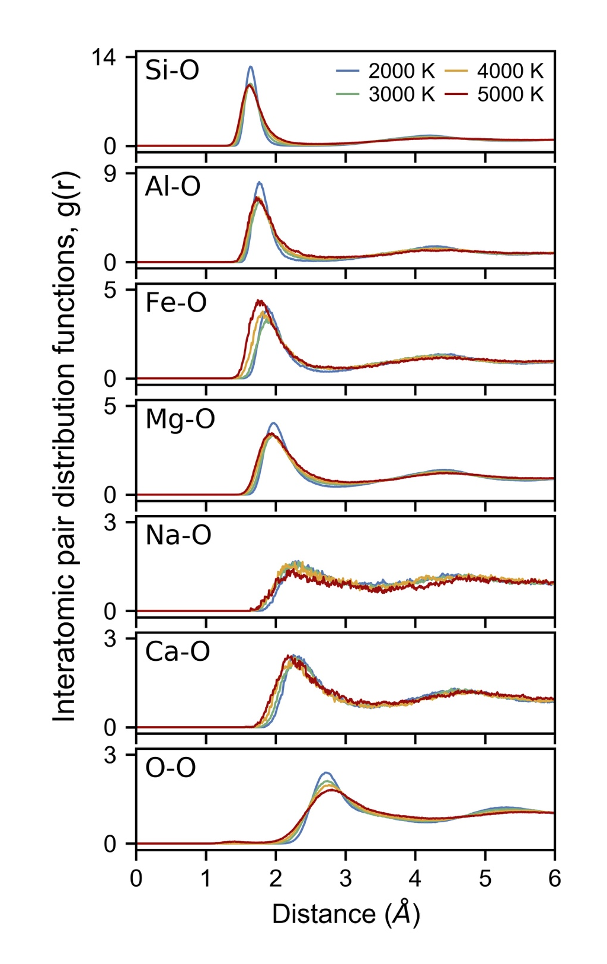
INTERATOMIC BONDING
Pair distribution function
Pure pyrolite (magma oceans)
Ambient P

Slide 17
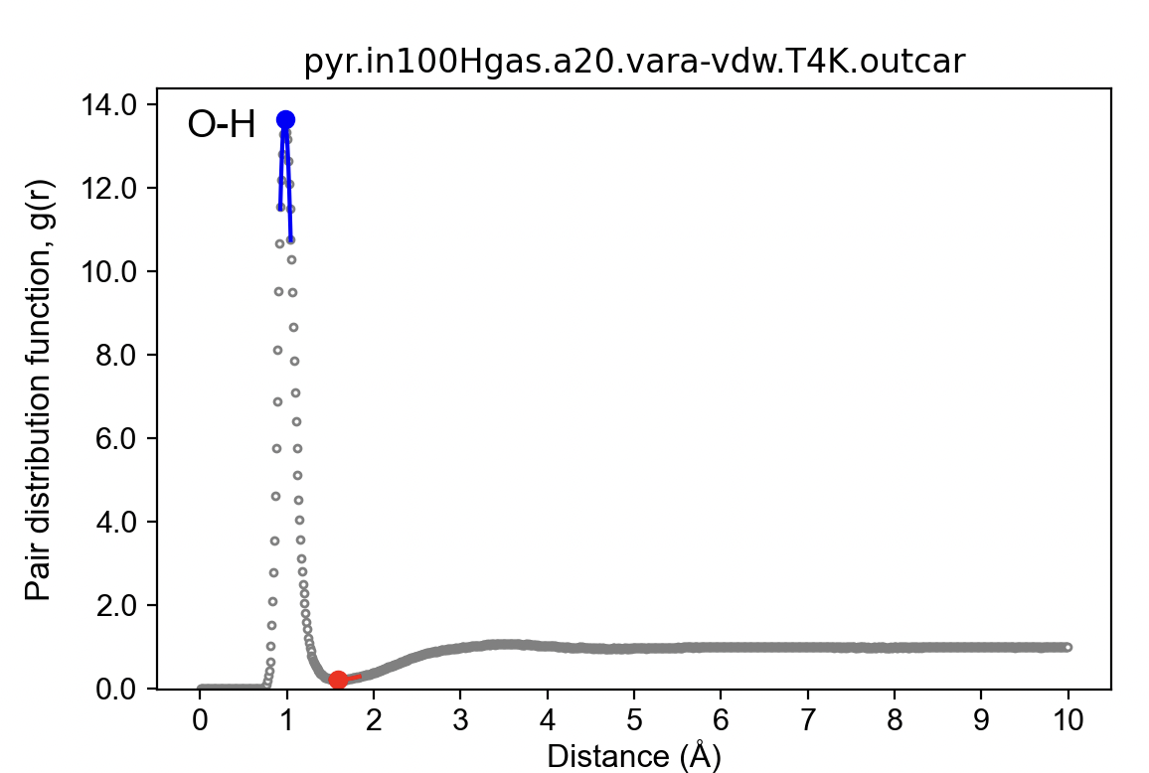
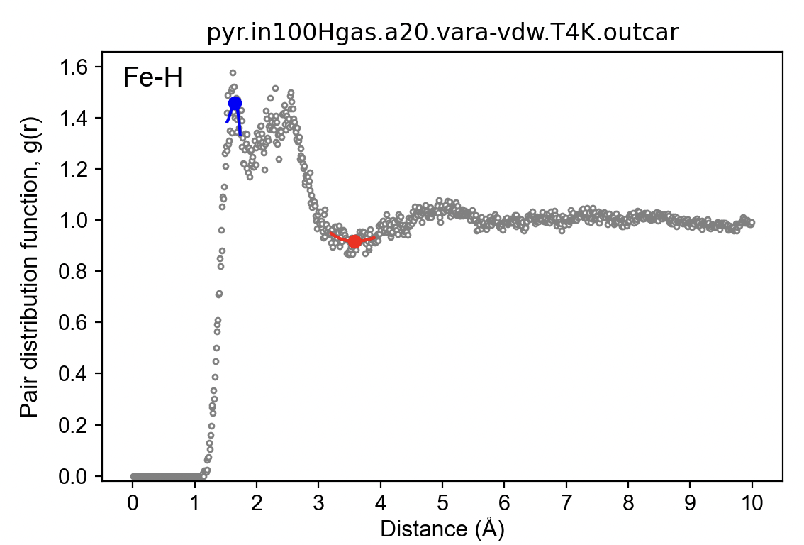
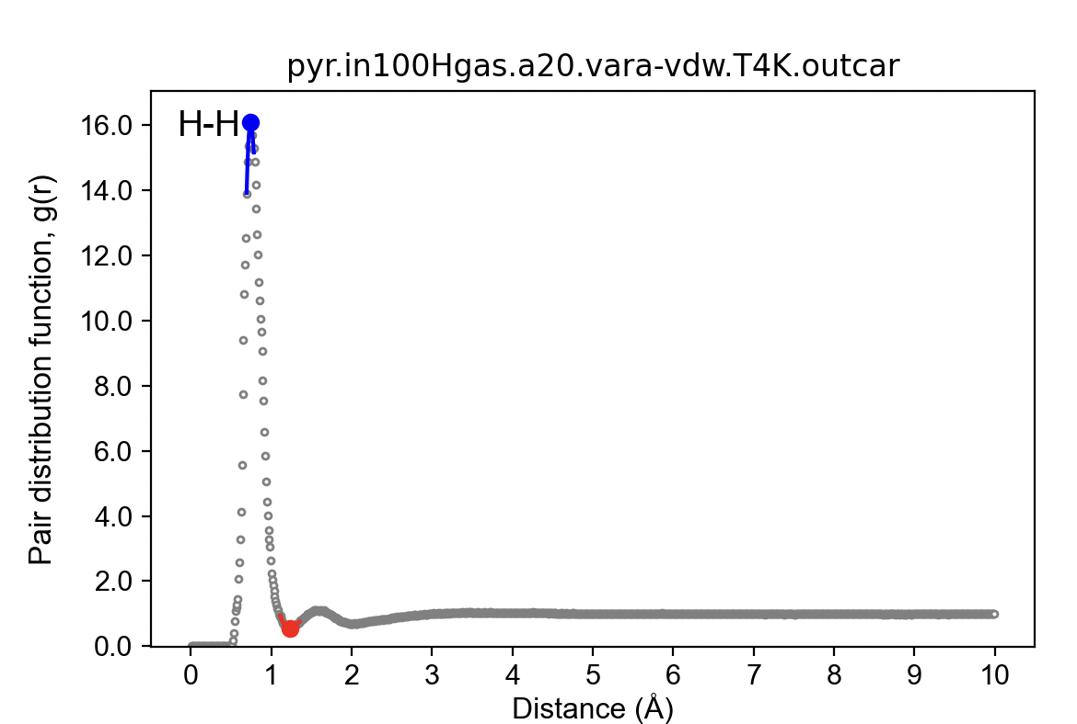
INTERATOMIC BONDING

